Slide 1

Data analysis using SQL
Zomato – A food delivery platform
Shri Varsha T

Slide 2

Understanding the data
In this project, we analyze data from Zomato, a leading online food delivery platform. The analysis focuses on various aspects of the platform’s operations, including customer behavior, order patterns, delivery efficiency, and restaurant performance.
To achieve this, we have used five datasets:
Customers
Orders
Deliveries
Restaurants
Riders

Slide 3



Understanding data
The customer table has data about the customers of the platforms.
The Restaurants table has data about the restaurants that provide service using the platform
The Riders table has data about the delivery partner working in the platform

Slide 4

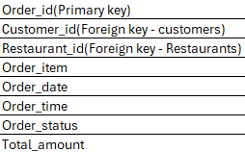
Understanding data
The Deliveries table has data of each delivery done via the platform.
The Orders table is the master table that connects all our tables. It has data of each order placed in the platform.

Slide 5

Objectives
Customer Behavior and Insights
Order and Sales Analysis
Restaurant Performance
Rider Performance
Operational Effectiveness

Slide 6
Data import
For this project, we are using MySQL as our database management system. We have created a dedicated database named Zomato, where all the relevant tables are created and populated using CSV data files.
We can import data in MySQL using two methods:
Using Table data Import Wizard – Preferable for smaller files.
Since the restaurants, riders and customers table have a smaller number of records we will import the data to these table using the wizard.
Using Command Prompt – Preferable for larger files.
Larger files might take more time to import using the table data import wizard, so we will be using the command prompt to import data into the orders and deliveries table. Unlike the Import Wizard, this method requires manual creation of the table before importing the data

Slide 7
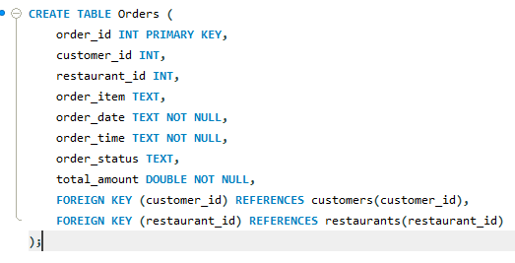
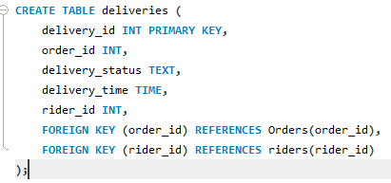
Data import using Command prompt:
First, we will create the tables orders and deliveries using the create statement
Orders Table Deliveries Table

Slide 8
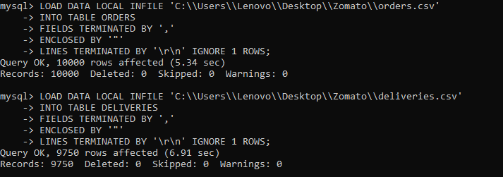
Data import using Command prompt:
Once the table is created, We'll now connect with MySQL database in command line prompt and set the global variables by using below command so that data can be imported from local computer folder.
mysql> SET GLOBAL local_infile=1;
Then load the table using the following commands

Slide 9
Data cleaning
Data cleaning is one of the most critical steps in any analysis or SQL project. It ensures the data is accurate, consistent, and usable for meaningful insights.
In our datasets we imported date and time attributes as text and the date format across the datasets are different, so we have converted the all attributes with date and time to date and time datatype using str_to_date function.
The STR_TO_DATE() function in SQL is used to convert a string into a DATE, DATETIME, or TIME data type by specifying the exact format of the string.
In our restaurants table we have column opening hours, we will extract the opening time and closing time from the opening hours for better usability, We have extracted these data using the text functions like trim, left, substring, locate.
Text functions are used to manipulate and analyze text or character data. They help remove extra spaces, extract specific parts of text, correct or replace values, locate characters or patterns, standardize text case, merge fields, and convert text into proper formats.

Slide 10
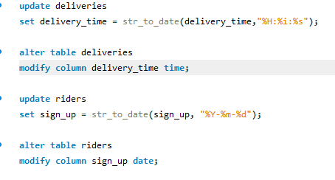
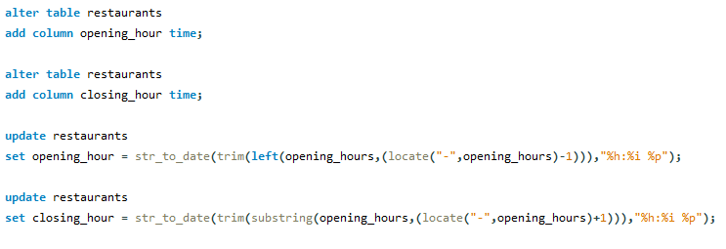
Data Cleaning
Converting date and time attributes using str_to_date() function.
Converting opening hours in restaurants to opening hour and closing hour using text functions.

Slide 11
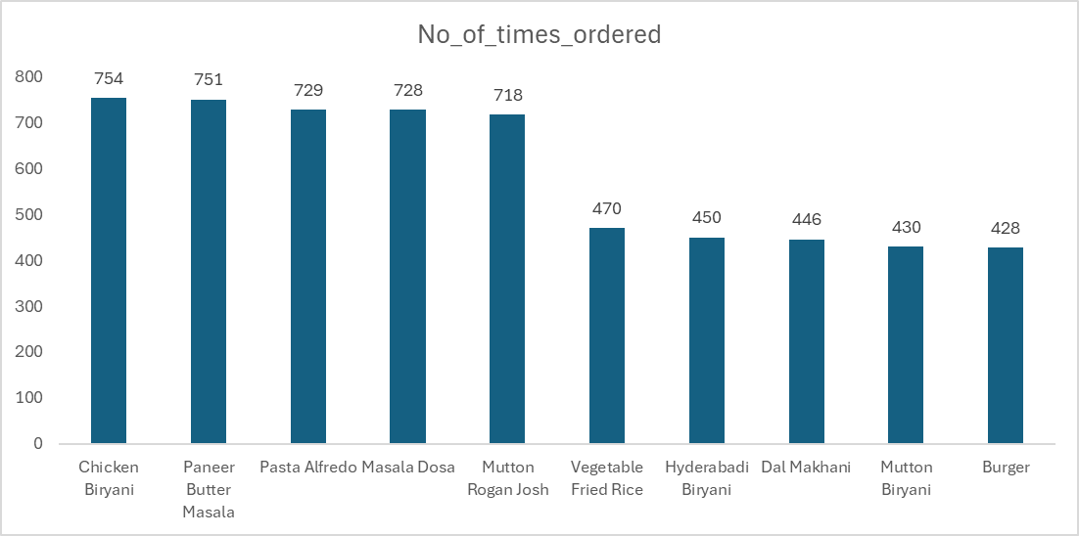
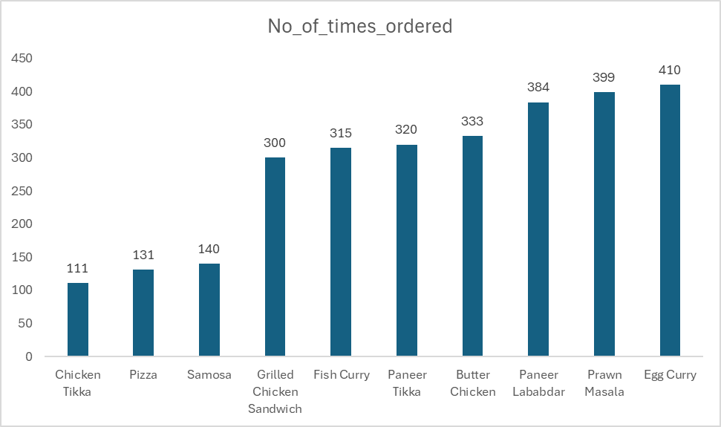
Most ordered and least ordered items
Top 10 most ordered items
Least ordered items

Slide 12
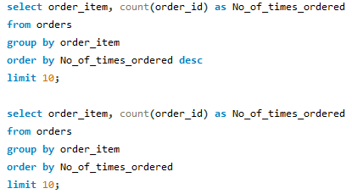
Most ordered and least ordered items
Chicken briyani and paneer butter masala are the most ordered items while chicken tikka is the least ordered item

Slide 13
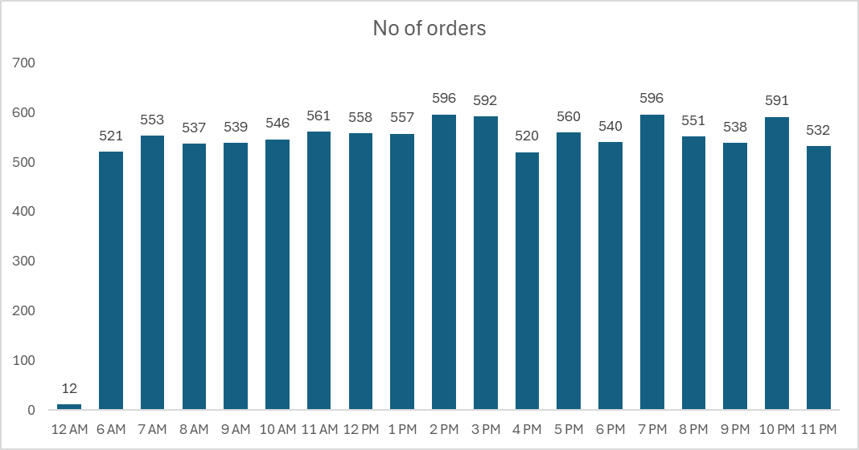
Popular time slots
The most popular time slots for orders are 2 PM and 7 PM, while order volume is noticeably lower between 11 PM and 6 AM, as well as around 4 PM.

Slide 14
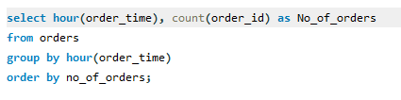
Popular time slots

Slide 15
Discount to customers with low overall order values
To boost sales, we will offer special discounts to customers whose total order value is below the overall average. A stored procedure will be executed to generate a list of these customers.
A Stored Procedure is a predefined, reusable set of SQL statements that are stored in the database and executed as a single unit.
Advantages:
Reusability
Improved Performance
Improved Security

Slide 16
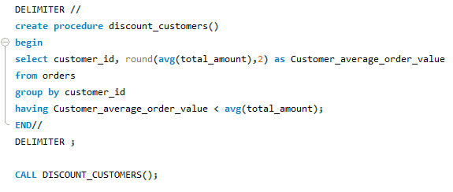
Discount to customers with low overall order values

Slide 17
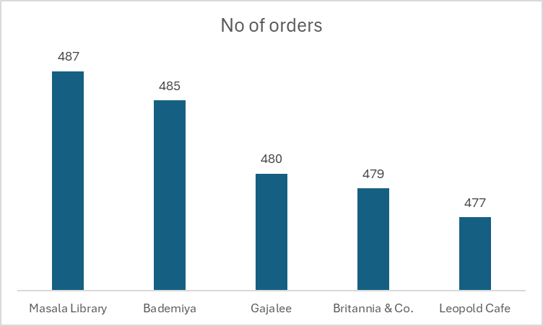
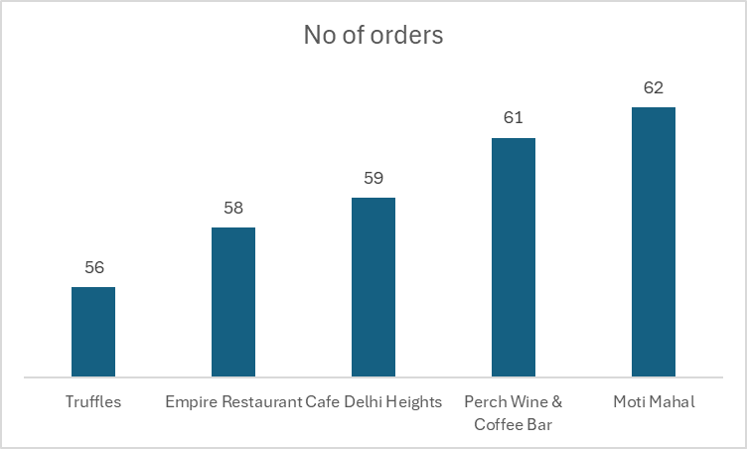
Most popular and least popular restaurants
Most popular restaurants
Least popular restaurants

Slide 18
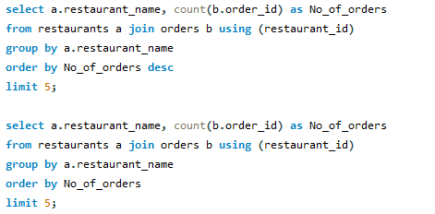
Most popular and least popular restaurants
Based on Number of orders, Masala library and Bademia has the highest number of orders and Truffles and Empire restaurant café has the least number of orders

Slide 19
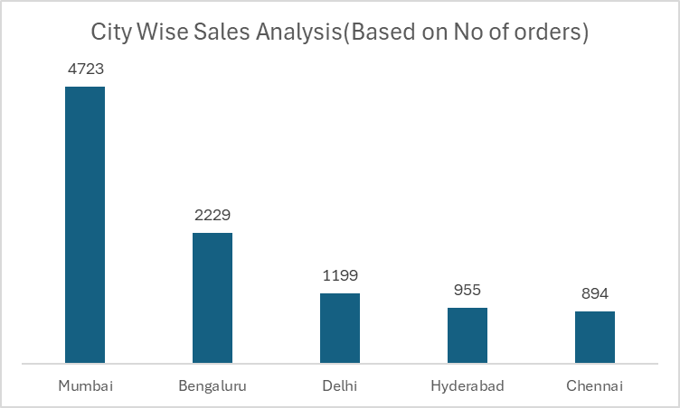
City wise sales analysis
Mumbai records the highest number of orders compared to other cities.
While Chennai and Hyderabad have relatively lower order volumes.

Slide 20

City wise sales analysis

Slide 21
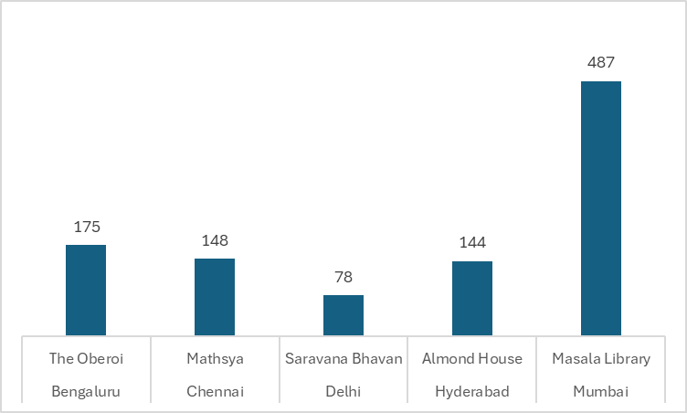
Top Ordered Restaurants Across Cities

Slide 22
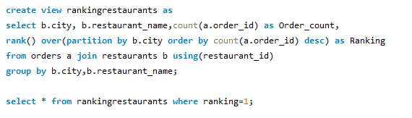
Top Ordered Restaurants Across Cities

Slide 23
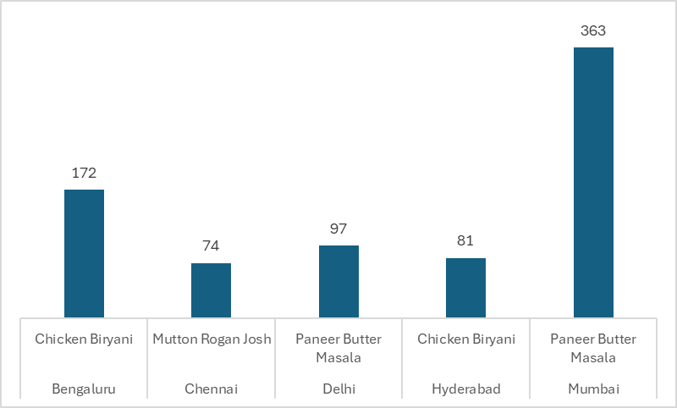
Top ordered items across cities

Slide 24
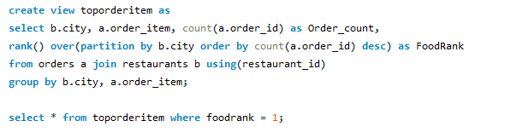
Top ordered items across cities (based on number of orders)

Slide 25
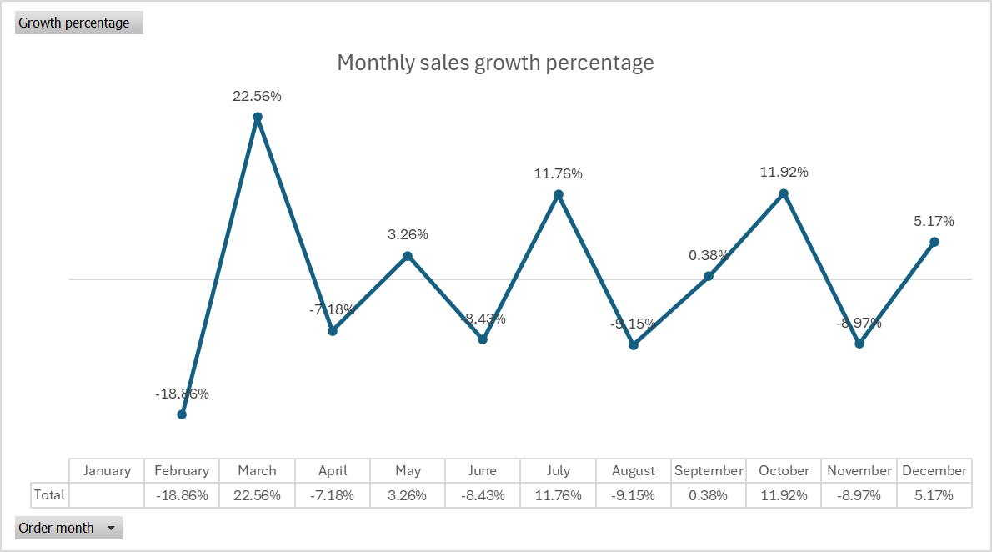
Monthly sales growth percentage based on number of orders per month

Slide 26
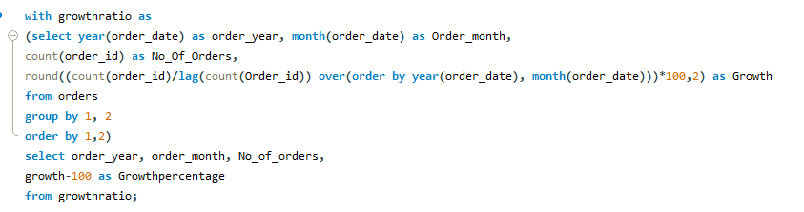
Monthly sales growth percentage based on number of orders per month

Slide 27
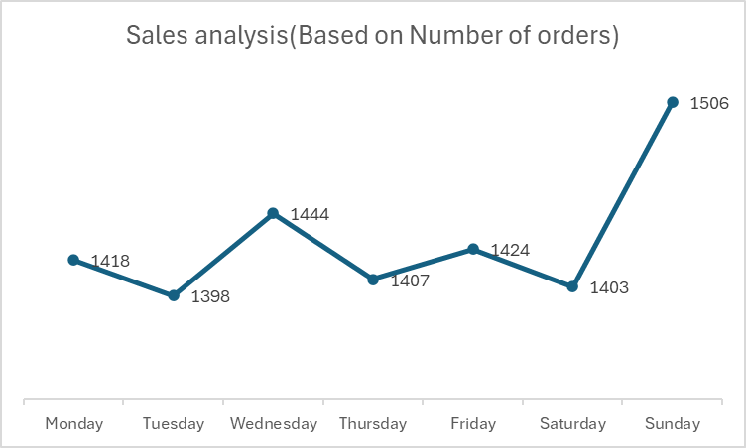
Sales Performance Across Weekdays
Sunday recorded the highest number of orders among all days.
While Tuesday and Saturday saw comparatively lower order volumes.

Slide 28
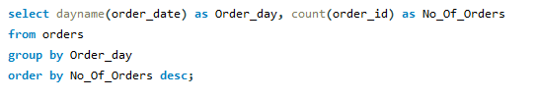
Sales Performance Across Weekdays

Slide 29
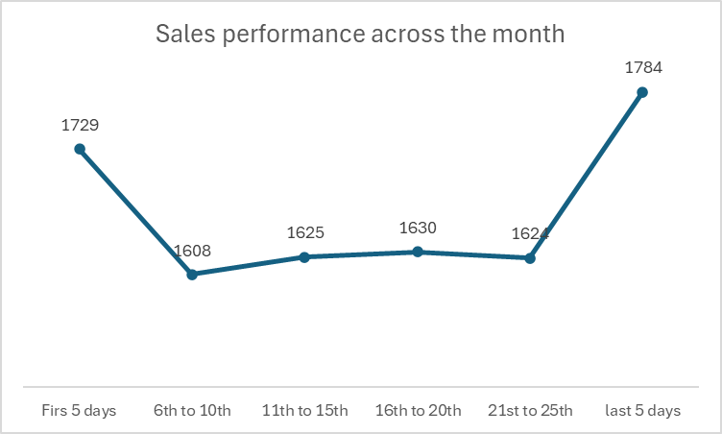
Sales performance across the month
The last 5 days and first 5 days of a month recorded the highest number of orders among all days.
While between 6th to 25th of every month saw comparatively lower order volumes.

Slide 30
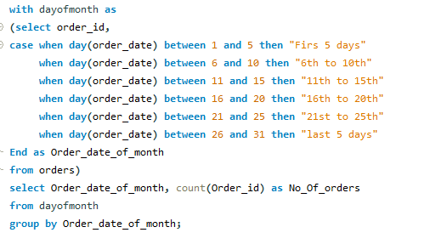
Sales performance across the month

Slide 31
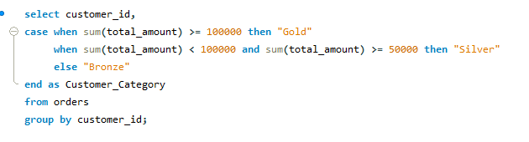
Customer categorization based on total order amount

Slide 32
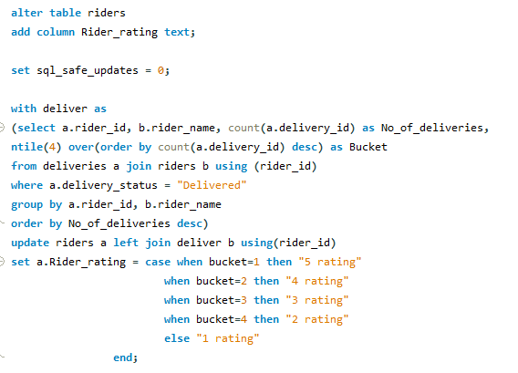
Rating riders based on Number of deliveries.

Slide 33
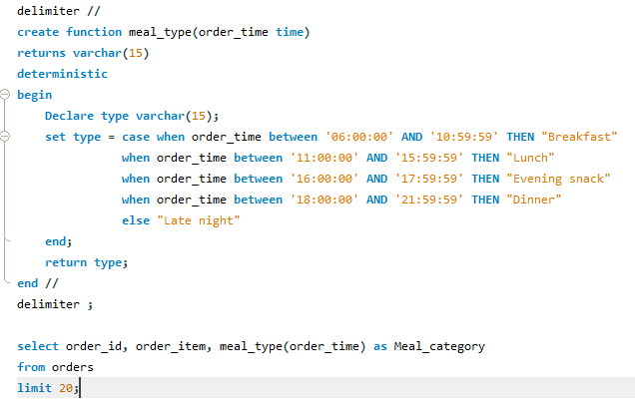
Meal categorization based on order time
To categorize orders based on the time they were placed, we created a user-defined function called meal_type. This function takes the order time as input and returns the corresponding meal category—such as Breakfast, Lunch, Dinner, or Late Night.

Slide 34
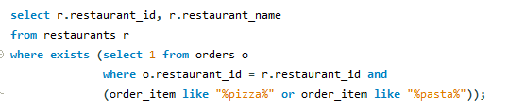
Restaurants with Italian cuisine
61 out of our 71 restaurants has Italian cuisine in the menu.

